Slide 1

FlightWithUs
MYSQL database design project

Slide 2

Project Overview
Objective: Design a MySQL database for a flight operator company based on given Excel data.
Scope: Data normalization up to 3NF, identification of database objects, creation of fields, and establishment of relationships.

Slide 3

Database Design
Database Design
3.1 Entity-Relationship (ER) Diagram
Entities: FlightOperator, Booking, Passenger, FlightDetails
Attributes: Define attributes for each entity based on Excel data and analysis.
Relationships: Identify and model relationships between entities (e.g., one-to-many, many-to-many).
Cardinality: Specify the maximum and minimum number of instances of one entity that can be related to instances of another entity.

Slide 4
Data Normalization
1NF: Ensure that each cell contains a single value and that all attributes within a table are dependent on the primary key.
1
2NF: Eliminate partial dependencies, ensuring that all non-key attributes are fully dependent on the primary key.
2
3NF: Remove transitive dependencies, ensuring that no non-key attribute is dependent on another non-key attribute.
3

Slide 5
Database Creation
MySQL Database: Create a new MySQL database named "FlightWithUs".
Identify Entities in ER diagram and corresponding attributes for Entities. Choose datatypes for attributes along with Relationships
Forward Engineer to generate and run script for creation of Tables and Constraints

Slide 6
TO DO
Data Loading
Import Data: Develop a script or use MySQL's import tools to load data from the Excel sheet into the database tables.
Data Cleaning: If necessary, clean and validate the data before importing to ensure accuracy.
6. Query Development
Sample Queries: Write example SQL queries to retrieve, insert, update, and delete data from the database.
Data Analysis: Develop queries to analyze flight data, such as calculating flight utilization, passenger statistics, and revenue analysis.
7. Documentation
ER Diagram: Provide a visual representation of the database design.
Data Dictionary: Create a detailed description of each table, column, and data type.
Query Examples: Include sample queries for common database operations.
Documentation: Document the database design, implementation process, and usage guidelines.

Slide 7
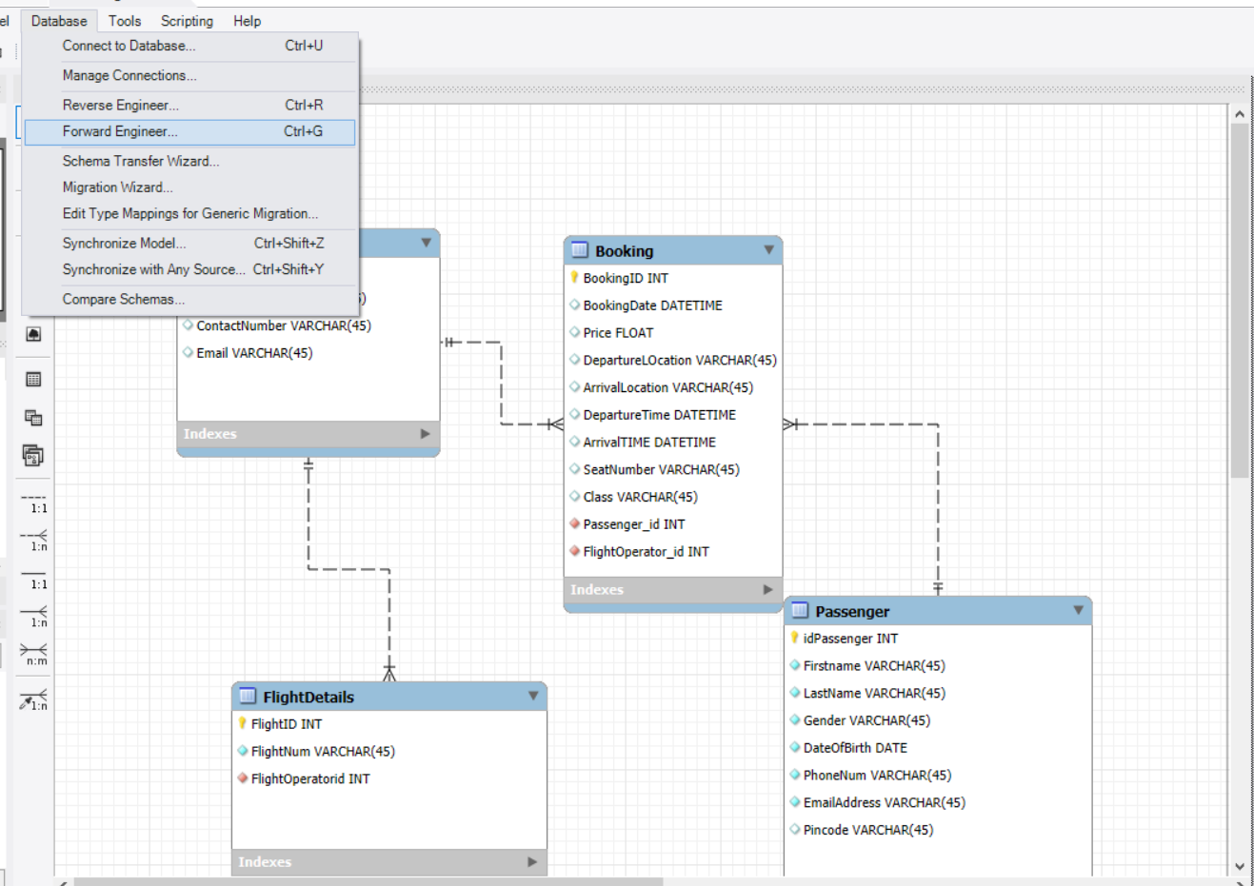
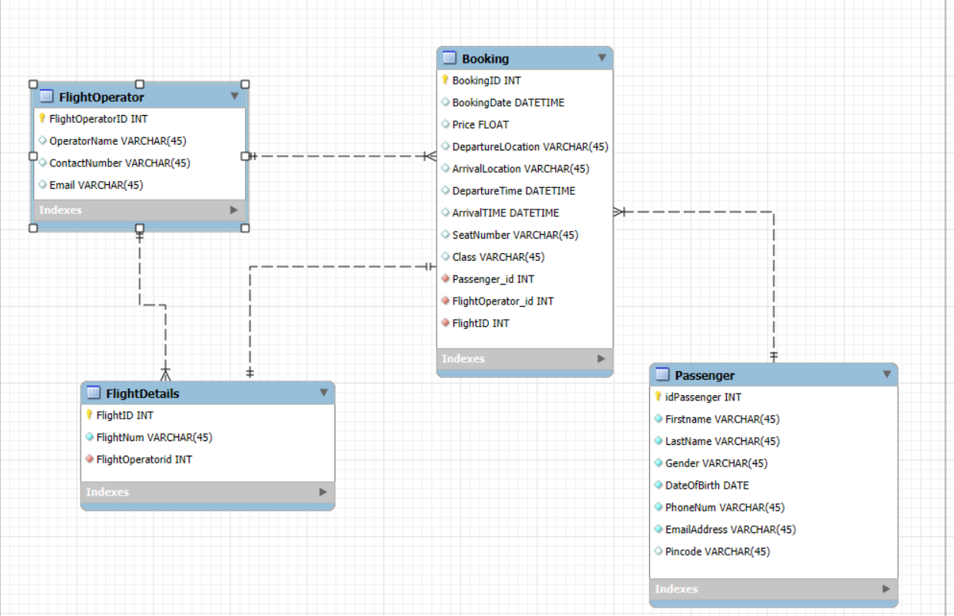
Screenshots of database creation

Slide 8
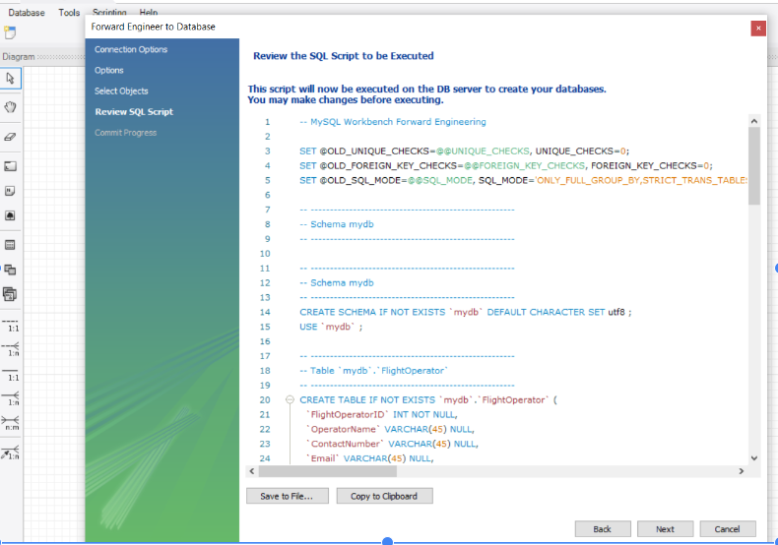
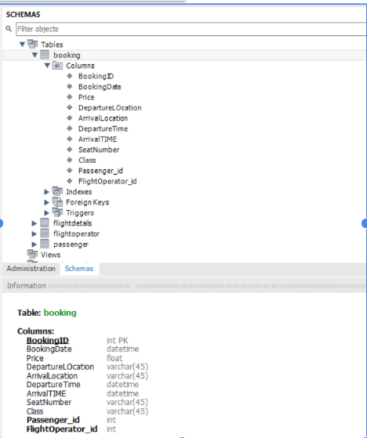
Screenshots of database creation

Slide 9

Any questions?
Thank you

